Slide 1
Working Remotely

Slide 2
Objectives
Recognize challenges of working remotely.
Identify tips for setting up your workspace, helping maintain work life balance and establishing routines.
Identify best practices for families, communicating with your team, utilizing technology and maintaining productivity.
Provide guidance for Supervisors and their teams while working remotely.

Slide 3
dfdfds
Expectation vs. Reality
Expectation | Reality
Wear whatever you want. | Maintaining grooming routines and dressing for work prepares you mentally for work. Video calls could be used while working remotely.
Hang out at home all day. | Working at home can be isolating day after day. Days can seem longer without typical workplace distractions.
See more of my family. | Frequent distractions caused by family can cause frustrations to run high.
Extra time in the morning to have a nice, relaxed breakfast. | Without a set routine people tend to wake up right before they need to logon to their computer.
Time to do chores. | You are expected to maintain your work schedule while you are at home.

Slide 4
dfdfds
Working from Home
Challenges
Missing social interaction with co-workers. | Sense of displacement – no face to face interaction with peers.
Adjustment period of working from home. | Work and home can begin to collide.
Requires mental discipline and self motivation. | Routines and structure are needed and must be intentional.
Family can cause distractions and disruptions. | Working all the time or “after” work hours.
Difficult to transition mentally from home to work and back. | Social isolation can be difficult, especially for those without family.

Slide 5
dfdfds
Skills needed to be successful
01
Self Motivated
02
Problem Solver
03
Great Communicator
Let’s see how you can set yourself up for success…

Slide 6
dfdfds
Setting up a workspace
Boundaries
Designate work space separate from home life.
If your work space has a door, close it during work hours to improve productivity.
Ambient Sound
A fan, white noise, and noise-cancelling headphones can help block distracting noise.
Close the Door
Helps boost mood and work satisfaction.
Natural Light

Slide 7
Setting Up a Workspace
Organizational
Tools
A white board, desktop calendar, and notepad keeps you organized.
You are still working and your behavior should remain professional.
Posture
Working from home can lead to poor posture. Sit up and stretch to decreases stress and increases productivity.
Minimize Distractions

Slide 8
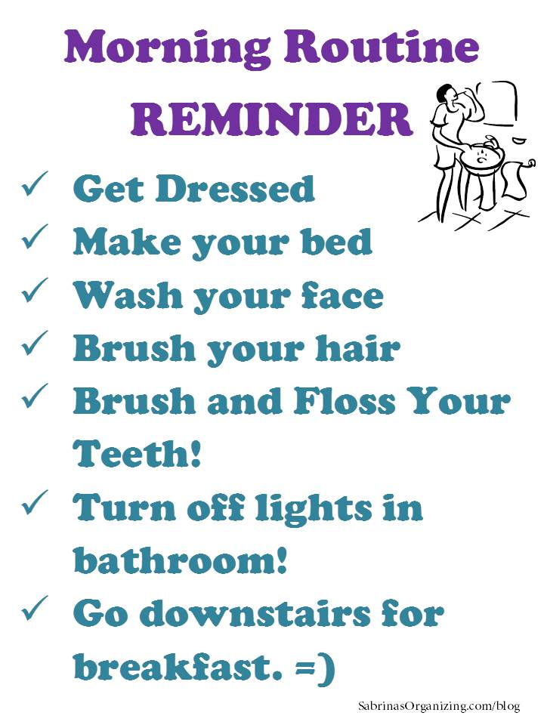
Work Life Balance
Keep Office Hours
Use Timers
Allows coworkers to know when you’re available.
Schedule a lunch time to ensure a lunch is taken.
Keep start and end times to prevent working all the time.
Set a time for breaks to prevent breaks from being too long.
Routines
Routines need to be more intentional when working from home.
Make a mental switch from home to work to prevent blurring the them together.

Slide 9
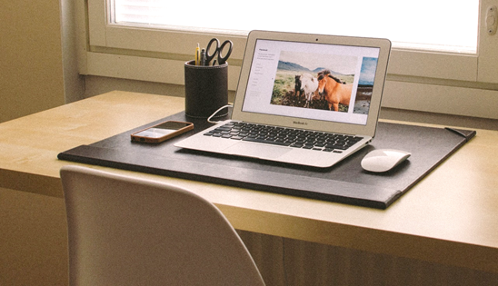
Routines
Morning Routine
End of Work Day Routine
Continue to practice your normal morning grooming routine and change out of your pajamas.
Physical Wellness – physical exercise/movement.
Mental Wellness – What do you need to do to help frame your attitude for the day? How can you get your day off to a good start?
Check and update your To Do List to set up the next work day.
Close your laptop when you are done working and leave it closed.
Focus on personal life, making a mental switch from work to home.

Slide 10
Considerations for Families
Define Office Hours
Set Boundaries
Do Not Disturb
Establish office hours to help your family know when you’re available and when you’re not.
Be clear with your family about what types of issues family members can interrupt you with. Clarify what is considered urgent.
If on a call or in a meeting, post a sign to let loved ones know you’re not to be disturbed at this time.
Once work is done, focus on life. Avoid checking laptop and phone.
Notes:
Adjust your expectations, show yourself some compassion
ID tag idea- wear your ID tag as an indicator that you are working
Instead of focusing on everything that is an obstacle, think about how you can use this time to reconnect and strengthen your family bond.

Slide 11
Communicating with Your Team
Be Clear
Communicate Often
Directly state what you need and by when you need it.
Be warm and personable since lack of non-verbal clues can lead to misinterpreted messages.
Share what challenges or barriers you are facing and might need help with.
Share your progress with your colleagues and your boss by scheduling weekly check ins.
It is better to over communicate than to not communicate enough.

Slide 12
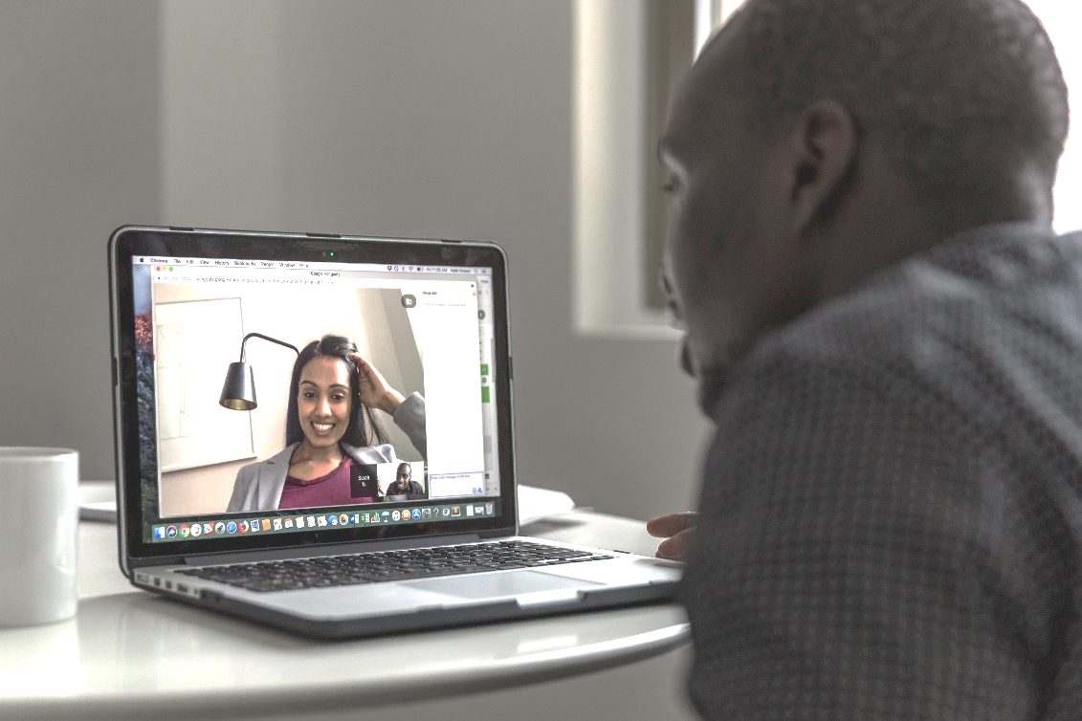
Using Technology
Email and Instant Messaging through
Phone calls
Video Calls
Take time to proofread.
Should be used to prevent too many emails being sent back and forth. Schedule phone calls when possible.
It is important for people to see each other to maintain team connectivity. Move past discomfort of being seen on video.
Be brief. Be clear. Be responsive.
Be smart – Subject to Open Records Requests.

Slide 13
Using Technology
When sharing documents, be clear on whether you are looking for comments, looking for others to add content or simply sharing information.
Utilize OneDrive to share files that need to be worked on simultaneously.
OneDrive offers control over files. You can give permission to users to edit files or give view only access.

Slide 14
Productivity
Front Load your Day
Daily Report
What did you accomplish yesterday?
Use a Timer
Use an App
Choose your most challenging tasks for the morning while you are focused.
Helps keep track of small tasks or time spent on big projects.
Apps can help keep track of time spent on social media, YouTube, news sites, etc.
What do you need to overcome those challenges?
What challenges stand in your way?
What are you planning to do today?
Outlook is a great tool to schedule your day and tasks.
Use a To-Do list to guide your day.
Notes:
Schedule an amount of time or a list of things that need to be completed that day
Breaks
Heavy duty brain work means shorter time of working before taking a break
Lighter work can go longer without a break
How do you manage your attention

Slide 15
Supervisors - Emotional Intelligence
Let your team see your vulnerabilities, such as homeschooling your children, taking care of elderly parents, etc.
Make space for employees to vent during this challenging situation.
Check in often with your employees. Ask them how they are doing. Video chat often if possible.
Discuss changes and challenges in their job assignments now that they are working from home. What should their priorities be?
Be cognizant of appreciation for employees – be proactive.

Slide 16
Supervisors Guidelines
Set Expectations
Technology
Communication
Send clear expectations on working remotely to team members.
Work schedule.
Prioritizing high impact tasks.
Long term projects and deadlines.
Schedule meetings with team and individuals often.
Use IT resources for guidance. Build in face time using Microsoft
Utilize OneDrive for collaboration.
Be intentional in maintaining contact.
Notes:
Communication:
You will need to communicate more frequently and more intentionally than you did before. Advice from some webinars I’ve seen: Have a goal of a specific number of my team I want to interact with each day.
During a meeting take a couple of minutes for a break, leave some space for casual chit chat
Seeing each other on video can be

Slide 17
Supervisors Communication
Ensure you have a current phone number for each individual on your team.
Determine best mode of communication between you and your staff.
Establish a plan for team communication. How often will you do check ins?
Establish a plan for communication with stakeholders.
Schedule meetings or phone calls online using Outlook and Microsoft
Assumptions serve no one
Notes:
What’s working and what needs adjustments
“What challenges are you having working from home? An exercise that can be done is called “start/stop/continue.” Ask your team, “What do you think we should start doing, what do you think we should stop doing, and what do you think we should continue doing?”

